Slide 1

House Prices Prediction
Abdulrahman Almegren – Yasir Albahlal

Slide 2
content:
-
Data
-
Data Cleaning
-
EDA
-
Models comparison
-
Final model

Slide 3
Data:
01
About 30000 house scraped from Aqar website
02
11 columns
03
PROJECT GOALS
04
9 Features and 1 predict (price)
The objective of this project is to predict Riyadh house prices.

Slide 4
Data Cleaning:
Drop or fix nulls
Delete duplicate rows
Rename columns and change datatypes
Drop outliers
Change some nulls with 0 and drop others
7500 duplicated row
Limit prices, area , apartments and street width
Rename Arabic columns and change objects to numerical

Slide 5
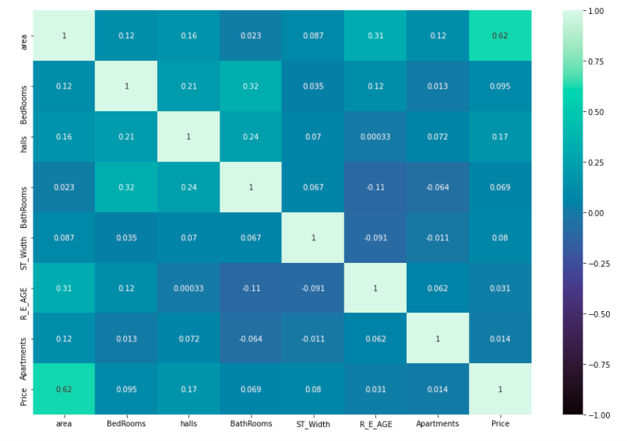
Features correlation
EDA

Slide 6
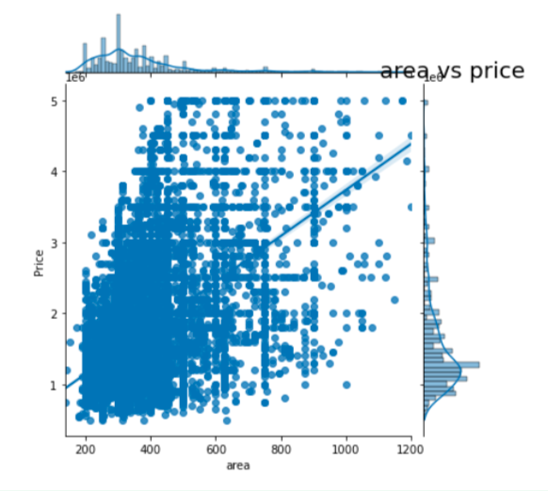
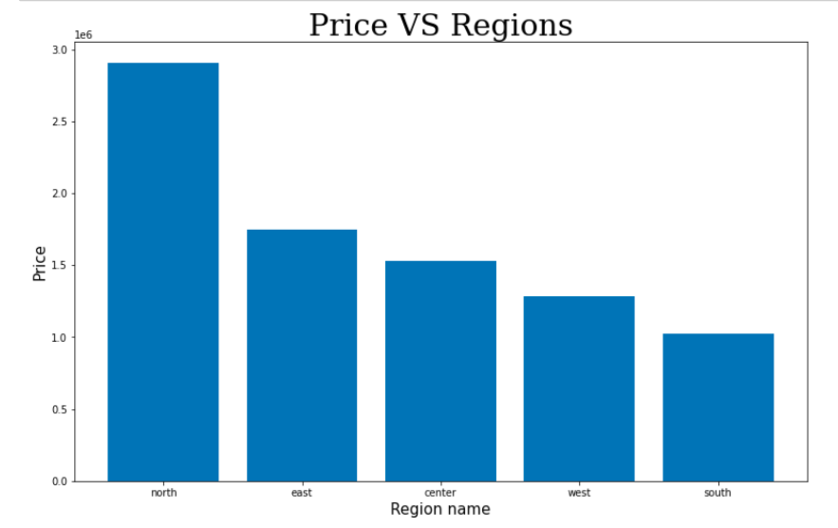
Price VS Regions and area

Slide 7
Comparing regression models:
Validation | Train | Regression name
0.761 | 0.745 | Linear Regression
- 0.778 | 0.800 | Polynomial(D=2)
0.761 | 0.745 | Lasso
0.761 | 0.745 | Ridge
0.785 | 0.792 | LassoCV with poly features

Slide 8
LassoCV with Polyfeatures
Based on the train and validation score we choose LassoCV with polyfeatures and apply the test on this regression.
AND
Conclusion
Best model is LassoCV with polynomial features.
Test | Validation | Train | Regression name
0.822 | 0.785 | 0.792 | LassoCV with polyfeatures

Slide 9
THANKS
Does anyone have any questions?
Please keep this slide for attribution

